Slide 1

What the ARS Model can do for us
ARS Hackathon Results Sharing
20 September 2023
Malan Bosman
Notes:
COSA / CDISC promoted event. I’m co-lead of the CDISC ARS standards team and a Product Owner of the ARS project. I’m a Principal and Co-founder of Clymb Clinical and a CDISC consultant. I’m very excited to lead this hackathon on behalf of the CDISC and COSA. I am also joined by members of the CDISC and COSA team here.

Slide 2
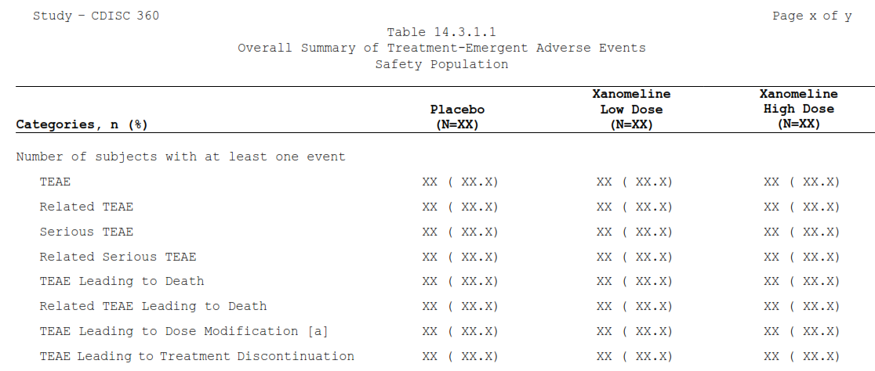
What if I told you…

Slide 3
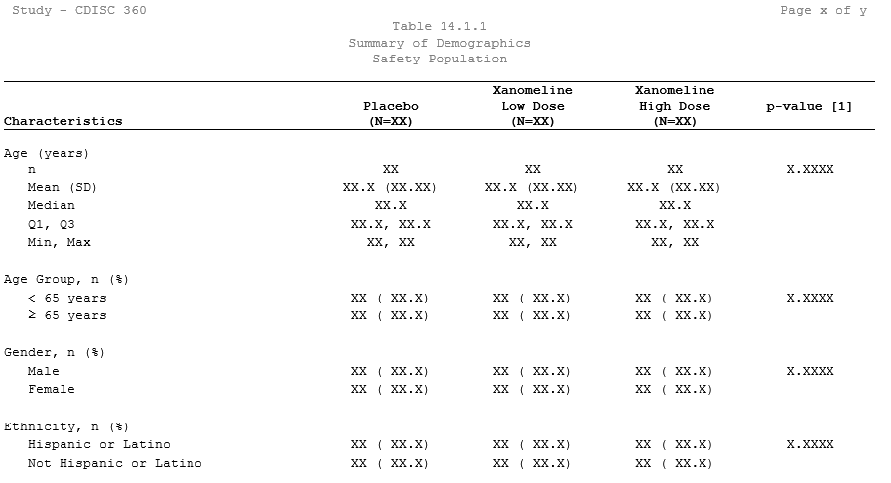
What if I told you…

Slide 4
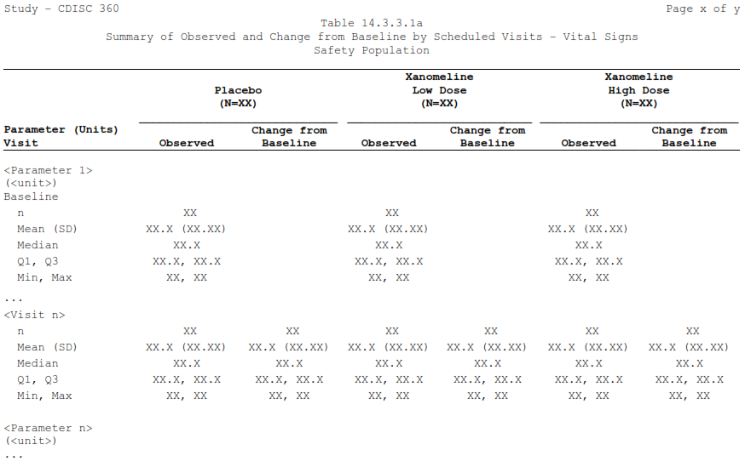
What if I told you…

Slide 5
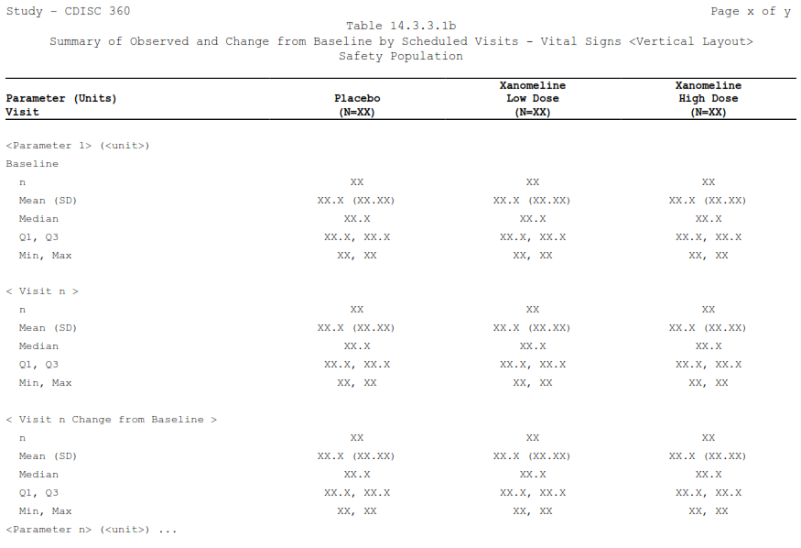
What if I told you…

Slide 6
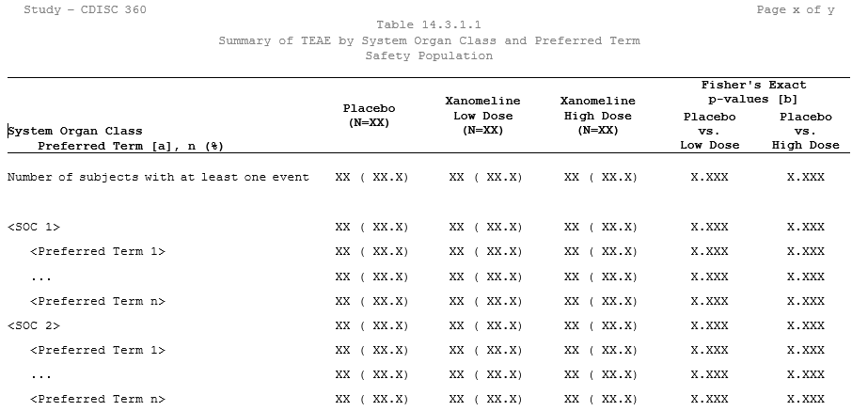
What if I told you…

Slide 7
What if I told you…
each result

Slide 8
What if I told you…
each result
for all outputs in a study

Slide 9
What if I told you…
each result
for all outputs in a study
Can be calculated…

Slide 10

What if I told you…
each result
for all outputs in a study
Can be calculated…
with one click

Slide 11
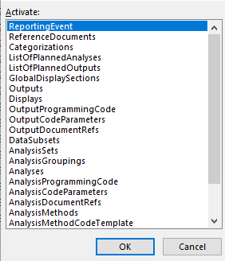
What if I told you…
each result
for all outputs in a study
Can be calculated…
with one click
referencing only metadata

Slide 12
What if I told you…
each result
for all outputs in a study
Can be calculated…
with one click
referencing only metadata
using open-source technology

Slide 13

What if I told you…
each result
for all outputs in a study
Can be calculated…
with one click
referencing only metadata
using open-source technology
Now, it’s possible!

Slide 14
Let’s illustrate…

Slide 15
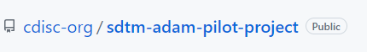
Let’s illustrate…
Example study:

Slide 16
Let’s illustrate…
Example study:
Objective:
Calculate all results (formatted) required for the safety outputs

Slide 17
Let’s illustrate…
Example study:
Objective:
Calculate all results (formatted) required for the safety outputs
1. Demographics table

Slide 18
Let’s illustrate…
Example study:
Objective:
Calculate all results (formatted) required for the safety outputs
2. Summary of Treatment-Emergent Adverse Events

Slide 19
Let’s illustrate…
Example study:
Objective:
Calculate all results (formatted) required for the safety outputs
3. Summary of TEAE by System Organ Class and Preferred Term

Slide 20
Let’s illustrate…
Example study:
Objective:
Calculate all results (formatted) required for the safety outputs
4. Summary of Observed and Change from Baseline by Scheduled Visits – Vital Signs

Slide 21
Let’s illustrate…
Example study:
Objective:
Calculate all results (formatted) required for the safety outputs
by using the ARS Model

Slide 22
Let’s illustrate…
Example study:
Objective:
Calculate all results (formatted) required for the safety outputs
by using the ARS Model
High-level method:

Slide 23
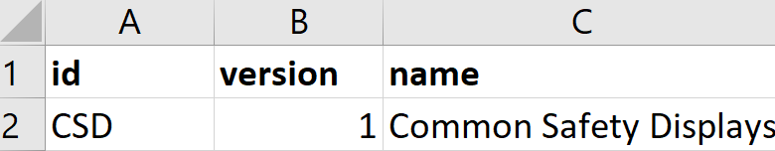
Let’s illustrate…
Example study:
Objective:
Calculate all results (formatted) required for the safety outputs
by using the ARS Model
High-level method:
- Utilise the populated Excel-version of the model

Slide 24

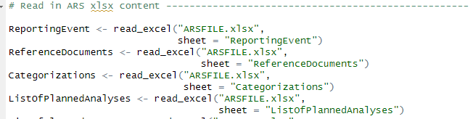
Let’s illustrate…
Example study:
Objective:
Calculate all results (formatted) required for the safety outputs
by using the ARS Model
High-level method:
- Utilise the populated Excel-version of the model
- Load into R

Slide 25
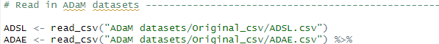
Let’s illustrate…
Example study:
Objective:
Calculate all results (formatted) required for the safety outputs
by using the ARS Model
High-level method:
- Utilise the populated Excel-version of the model
- Load into R
- Load applicable ADaM datasets into R

Slide 26
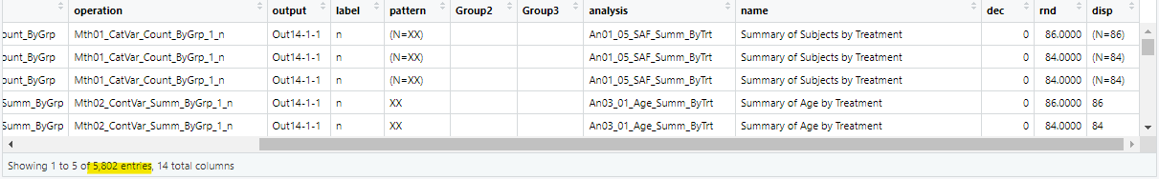
Let’s illustrate…
Example study:
Objective:
Calculate all results (formatted) required for the safety outputs
by using the ARS Model
High-level method:
- Utilise the populated Excel-version of the model
- Load into R
- Load applicable ADaM datasets into R
- > 1000 lines of code later… produce results to a single dataset!

Slide 27
Let’s illustrate…
Example study:
Objective:
Calculate all results (formatted) required for the safety outputs
by using the ARS Model
High-level method:
- Utilise the populated Excel-version of the model
- Load into R
- Load applicable ADaM datasets into R
- > 1000 lines of code later… produce results to a single dataset!

Slide 28
My programming approach…
Loop through ListOfPlannedOutputs

Slide 29
My programming approach…
Loop through ListOfPlannedOutputs
Loop through ListOfPlannedAnalyses

Slide 30
My programming approach…
Loop through ListOfPlannedOutputs
Loop through ListOfPlannedAnalyses
For each analysis, apply all groupings, subsets, operations, etc.

Slide 31
My programming approach…
Loop through ListOfPlannedOutputs
Loop through ListOfPlannedAnalyses
For each analysis, apply all groupings, subsets, operations, etc.
Keep appending to the Results Dataset, until each output’s analyses
are all added

Slide 32
My findings…

Slide 33
My findings…
The model seems complex…

Slide 34
My findings…
The model seems complex…
but it needs complexity to contain and link all metadata

Slide 35
My findings…
The model seems complex…
but it needs complexity to contain and link all metadata
We can build an “operation library”

Slide 36
My findings…
The model seems complex…
but it needs complexity to contain and link all metadata
We can build an “operation library”…
Each operation has a “block of code”, and operations are transferrable to
other Reporting Events. We do need to keep the names and parameter
lists of operations consistent

Slide 37
My findings…
The model seems complex…
but it needs complexity to contain and link all metadata
We can build an “operation library”…
Each operation has a “block of code”, and operations are transferrable to
other Reporting Events. We do need to keep the names and parameter
lists of operations consistent
Some operations would require additional metadata

Slide 38
My findings…
The model seems complex…
but it needs complexity to contain and link all metadata
We can build an “operation library”…
Each operation has a “block of code”, and operations are transferrable to
other Reporting Events. We do need to keep the names and parameter
lists of operations consistent
Some operations would require additional metadata
I found that the Fisher’s exact t-test would be easier to execute with
additional metadata. This might also be the case for other (complex)
operations

Slide 39
Next steps
Build a tool that helps the user populate the model from study documents

Slide 40
Next steps
Build a tool that helps the user populate the model from study documents
Think about how the “results dataset” can be utilized to populate outputs

Slide 41
Thank you!

Slide 42
Contact Details
Malan Bosman
Malan.bosman@iconplc.com
+27712286941

